Slide 1
Heat Exchanger Selection & Mounting
Hand Calculations & FEA

Slide 2
Table of Contents
Problem
Costs/Advantages
Coolant Temp
Flowrate
Heat Rejection
Heat Exchanger
System Architecture
Selected Location
Mount FEA

Slide 3
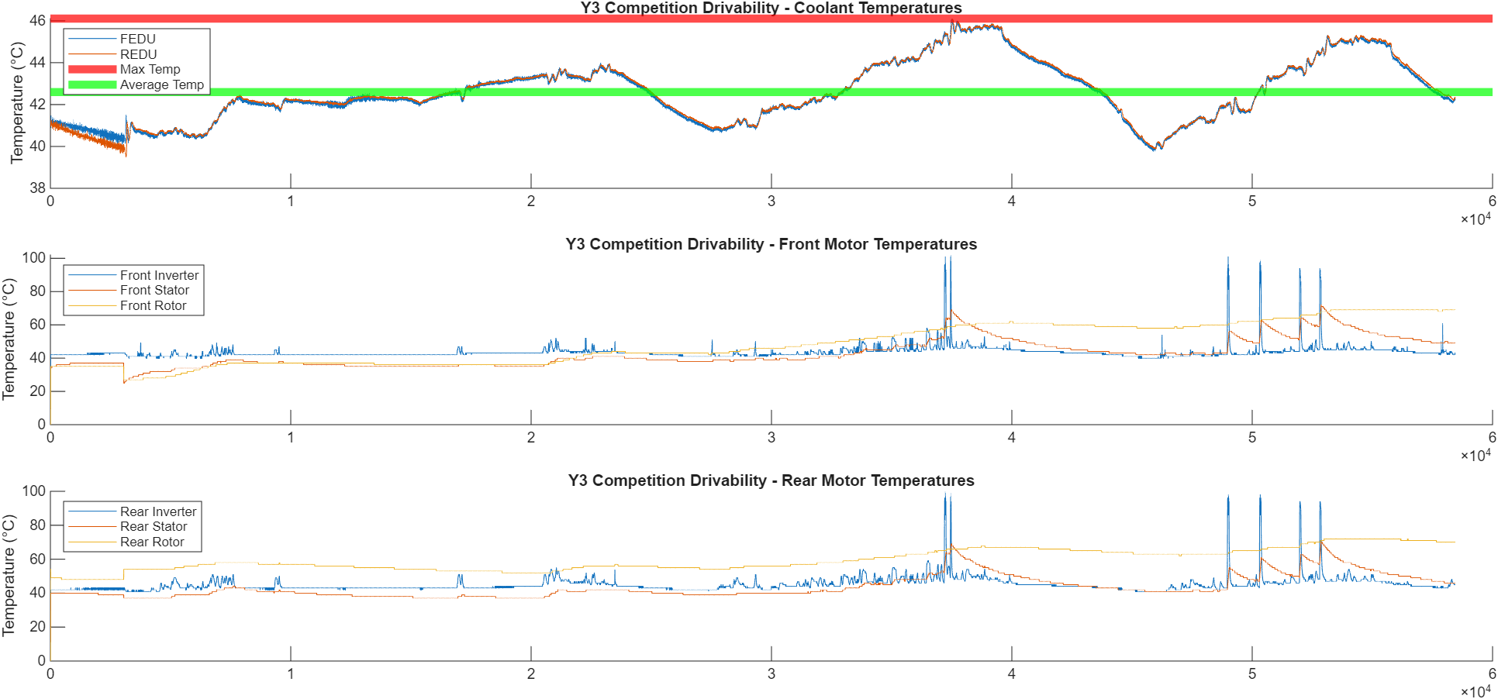
Problem - Overheating

Slide 4
Problem - Overheating
This issue is manageable in software (we can add a hysteresis so the torque doesn’t oscillate so much)
The actual temperature limit is different than what Magna originally indicated
Was 105°C -> Now 130°C
Increasing the flow should completely remove this issue

Slide 5
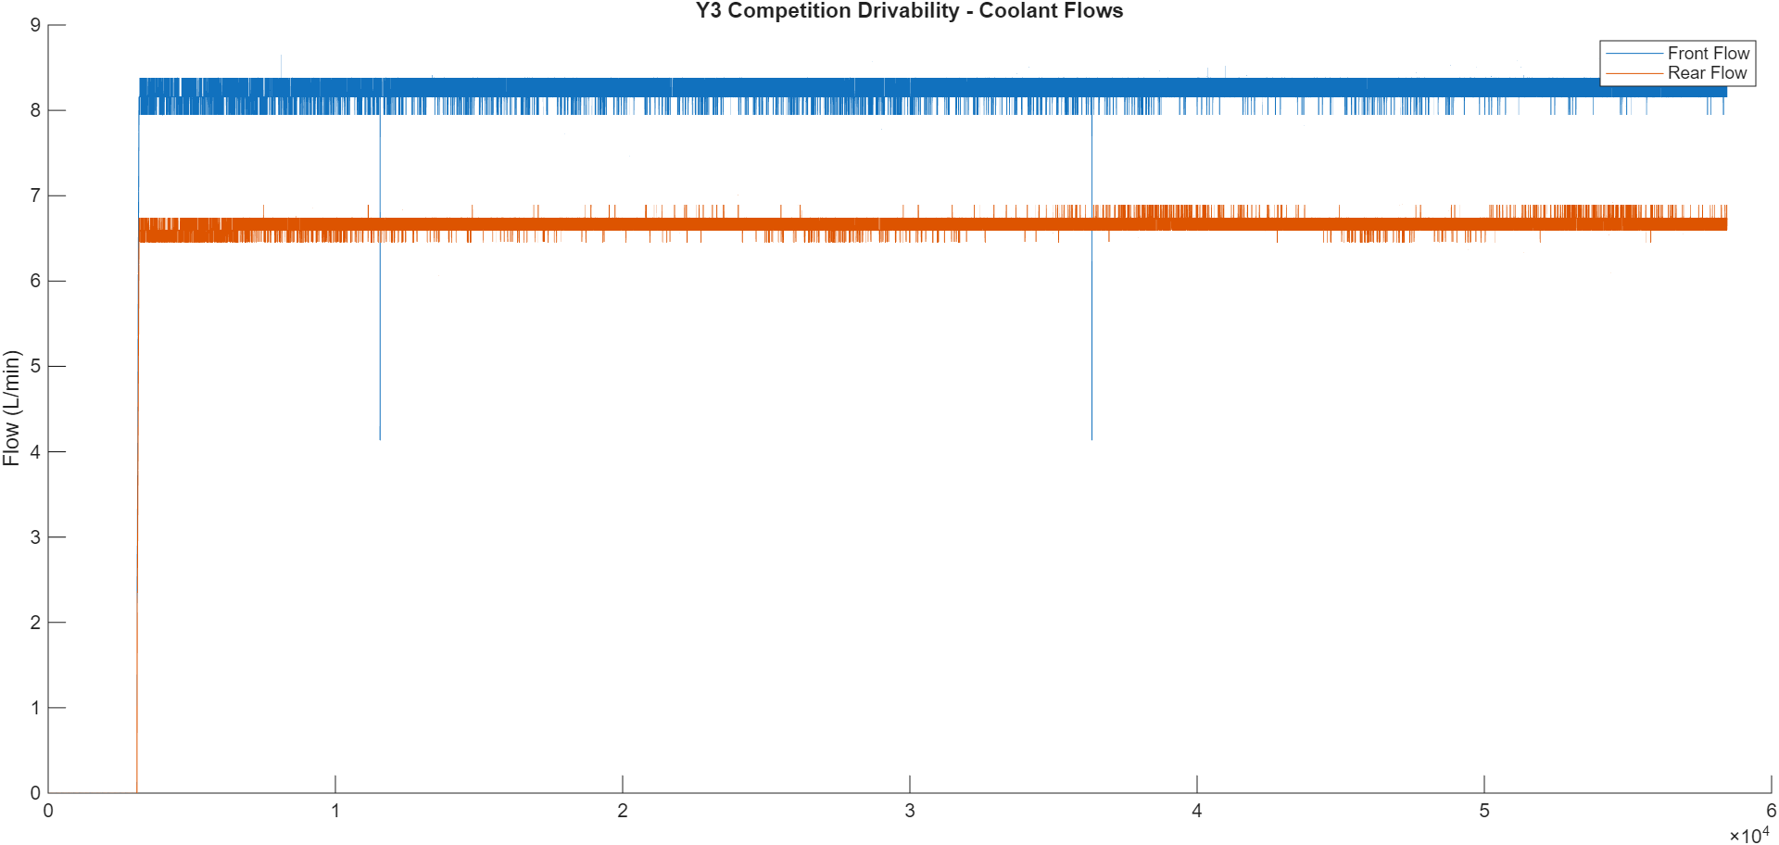
Problem – Boost Mode Inoperable
Boost Mode Requirement:
> 8 L/min
Ideal Nominal Flow:
10 L/min
System Flow:
Front: 7.95 L/min
Rear: 6.60 L/min

Slide 6
Costs/Advantages
Current System
Cost: $0
Points: -45/1000 (for 0-60 and 50-70 acceleration)
Time: 0
Risk: No boost mode or maximum performance
Modified System
Cost: $1k-3k
Points: +45/1000 (for 0-60 and 50-70 acceleration)
Time:
60+ hrs design
30+ hrs manufacturing
Risk:
Vehicle not ready for CARB
Motors overheat more

Slide 7
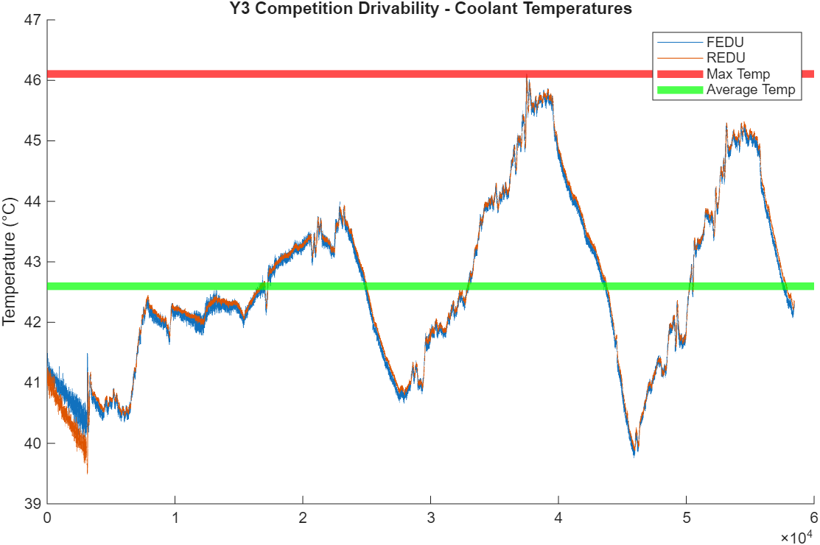
Coolant Temp
Max Coolant Temp = 46.11 °C
Nominal = 42.6 °C
Note: Max coolant temp during CARB PCM energy consumption event = 36.5 °C
Max Allowable Coolant Temp = 57 °C
Magna EDU requirement
This data proves the radiator is sufficient for thermal rejection of system

Slide 8
Flowrate
Current:
Front: 7.95 L/min
Rear: 6.60 L/min
Desired:
Front: 10 L/min
Rear: 10 L/min
Nominal (max)
20 (25) L/min
5.28 (6.60) GPM

Slide 9
Heat Rejection
Maximum
91,746 BTU/Hr
26.888 kW
Nominal
25,796 BTU/Hr
7.56 kW

Slide 10
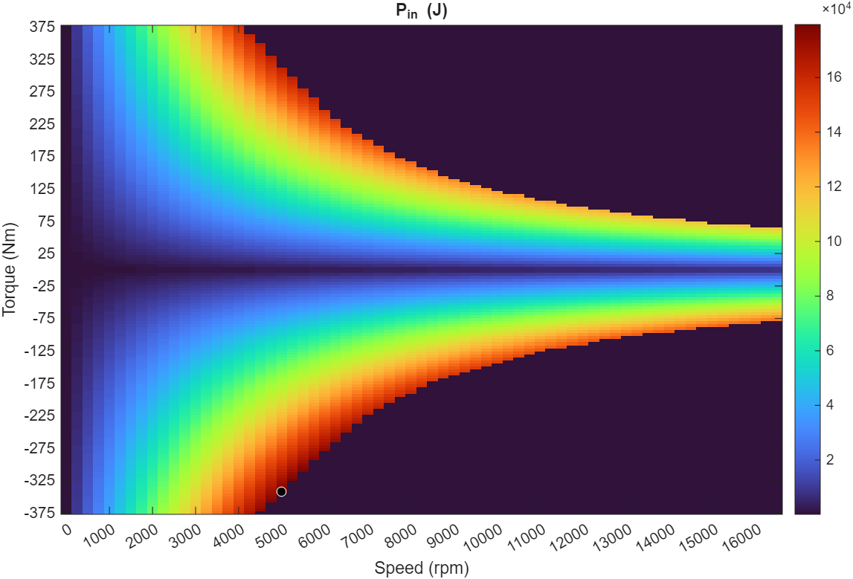


Heat Rejection - Power
Power = Work / Time
$P=\frac{W[J]}{t[s]}=\frac{F\left[N\right]r\left[m\right]}{t[s]}=τ\left[Nm\right]∗ω\left[\frac{rad}{s}\right]$
$P=τ\left[Nm\right]∗rpm\left[\frac{rev}{min}\right]∗\frac{2π}{60}$
$J=\frac{kgm^{2}}{s^{2}}=Nm=\frac{kgm}{s^{2}}∗m$
$N=\frac{kgm}{s^{2}}$
$ω\left[\frac{rad}{s}\right]=rpm\left[\frac{rev}{min}\right]∗\frac{1min}{60s}∗\frac{2πrad}{1rev}$

Slide 11
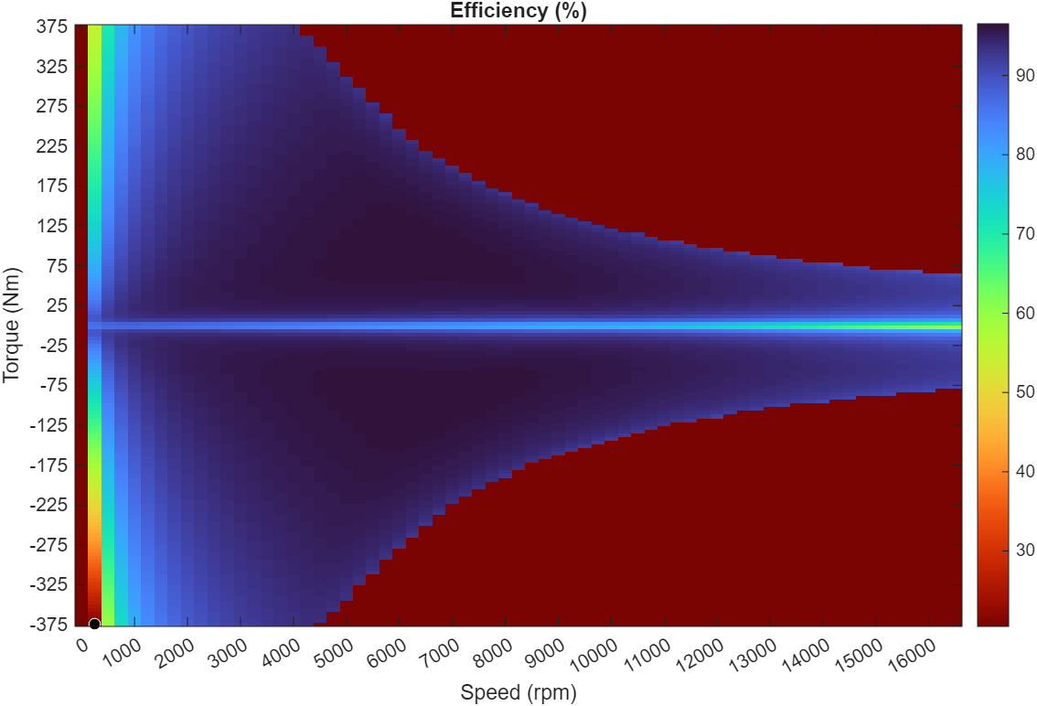

Heat Rejection - Efficiency
Confidential Efficiency Map for the Electric Drive Units
$η=\frac{P_{out}}{P_{in}}∗100\%$
$P_{out}=\frac{η}{100}P_{in}$
$P_{in}=P_{out}+P_{loss}$
$P_{loss}=P_{in}−P_{out}$

Slide 12
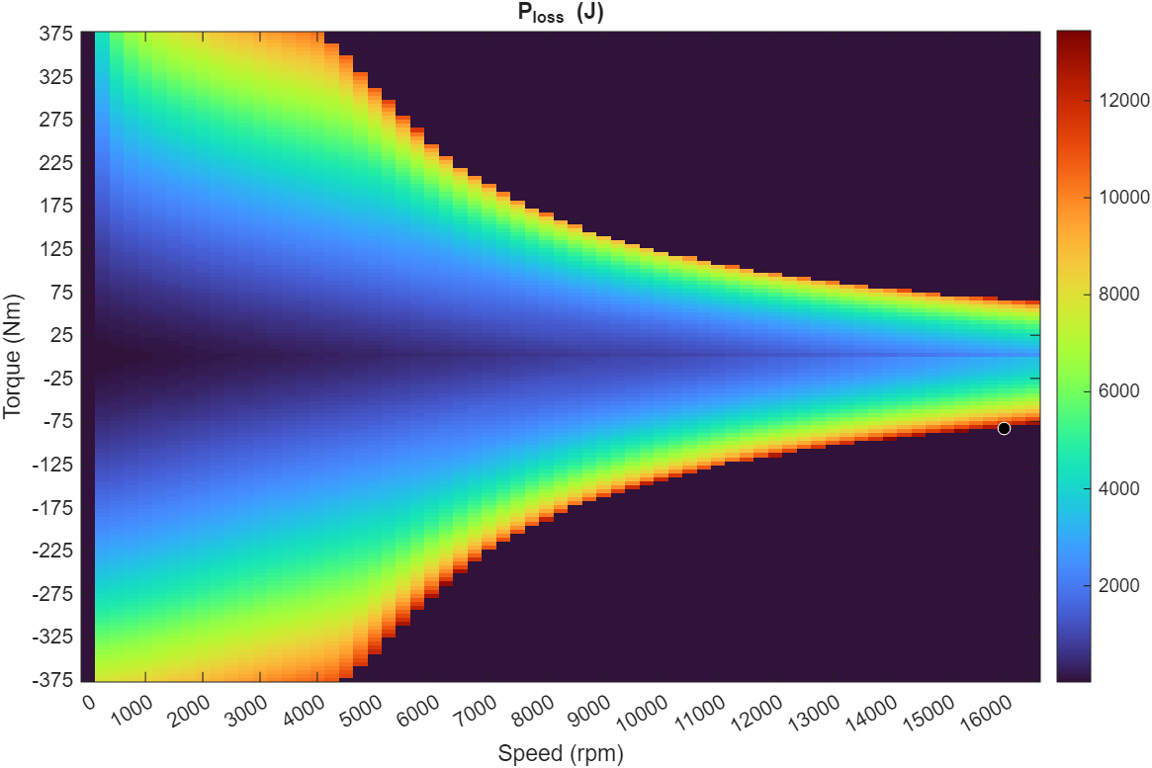
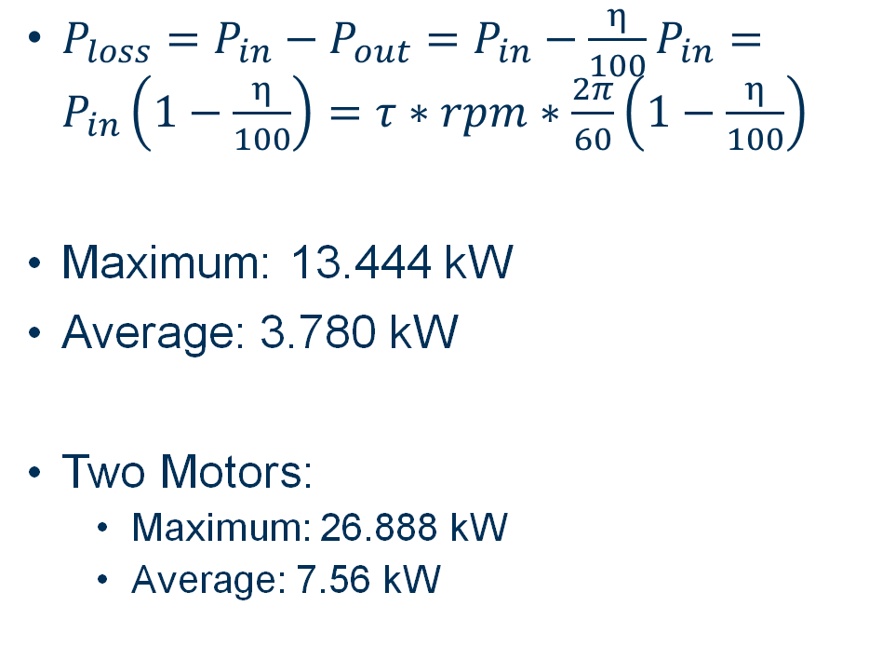
Heat Rejection - Power Loss
Confidential Power Loss Map for the Electric Drive Units
$P_{loss}=P_{in}−P_{out}=P_{in}−\frac{η}{100}P_{in}=P_{in}\left(1−\frac{η}{100}\right)=τ∗rpm∗\frac{2π}{60}\left(1−\frac{η}{100}\right)$
Maximum: 13.444 kW
Average: 3.780 kW
Two Motors:
Maximum: 26.888 kW
Average: 7.56 kW

Slide 13
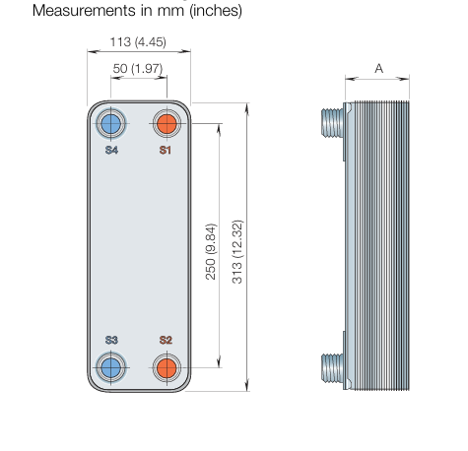
Heat Exchanger Selected
For more information, see the following slides in this section which cover alternatives and more of the reasoning.
Max Pressure: 3100 kPa
Max Temperature: 204 °C
Weight: 6.97 lb
Cost: $ 564.51
Total Area: 0.636 m^2
Pressure Drop: 7 kPa
Max Flow: 62 GPM
CB30-18H - Alfa Laval CB30-18H - 450,000 BTU/Hr (Domestic Water) CB30 Brazed Plate Heat Exchanger (18 Plates)

Slide 14

Heat Exchanger Bell & Gossett
Water - Water
99,900 > 91,746 BTU/Hr
5.4 > 5.28 GPM
Weight: 3.00 lb
Cost: $386.19
Propylene - Water
87,900 ~ 91,746 BTU/Hr
5.41 > 5.28 GPM
Weight: 74.00 lb
Cost: $6357.95
bell-&-gossett-brazed-plate-heat-exchanger-selection-tables.pdf

Slide 15
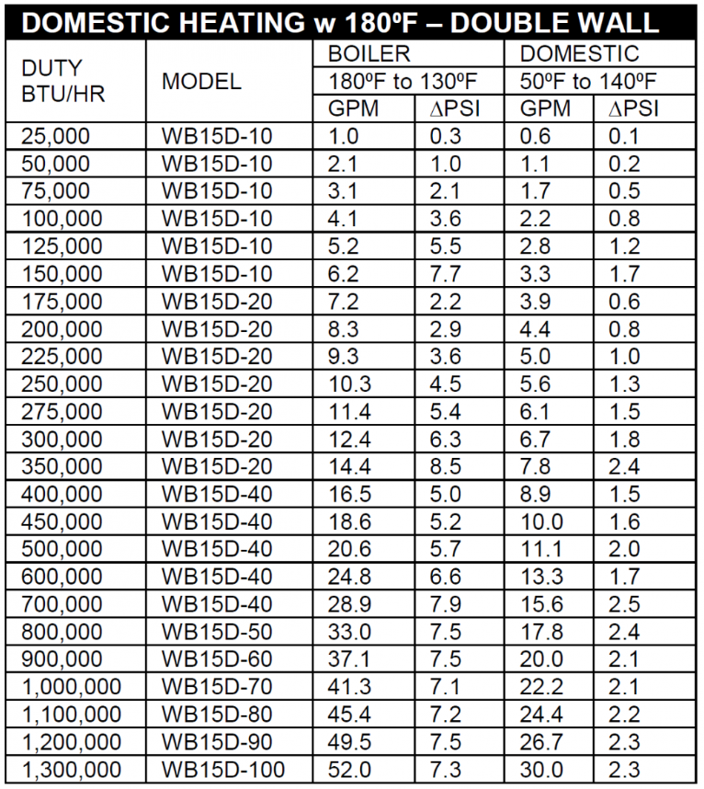
Heat Exchanger Wessels
Water - Water
125,000 > 91,746 BTU/Hr
5.2 ~ 5.28 GPM
Weight: 5 lb
Cost: ?
How To: Size Brazed Plate Heat Exchangers | Wessels Company

Slide 16
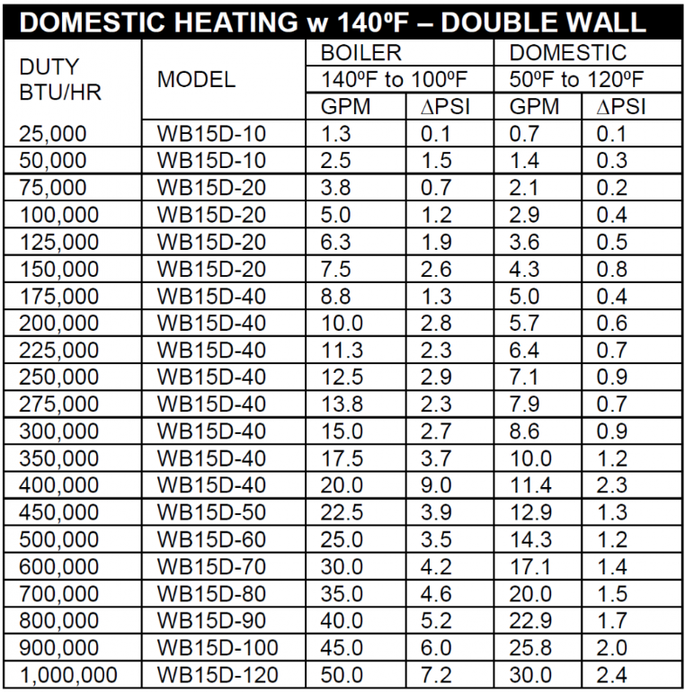
Heat Exchanger Wessels
Water - Water
100,000 > 91,746 BTU/Hr
5.0 ~ 5.28 GPM
Weight: 5 lb
Cost: ?
How To: Size Brazed Plate Heat Exchangers | Wessels Company

Slide 17
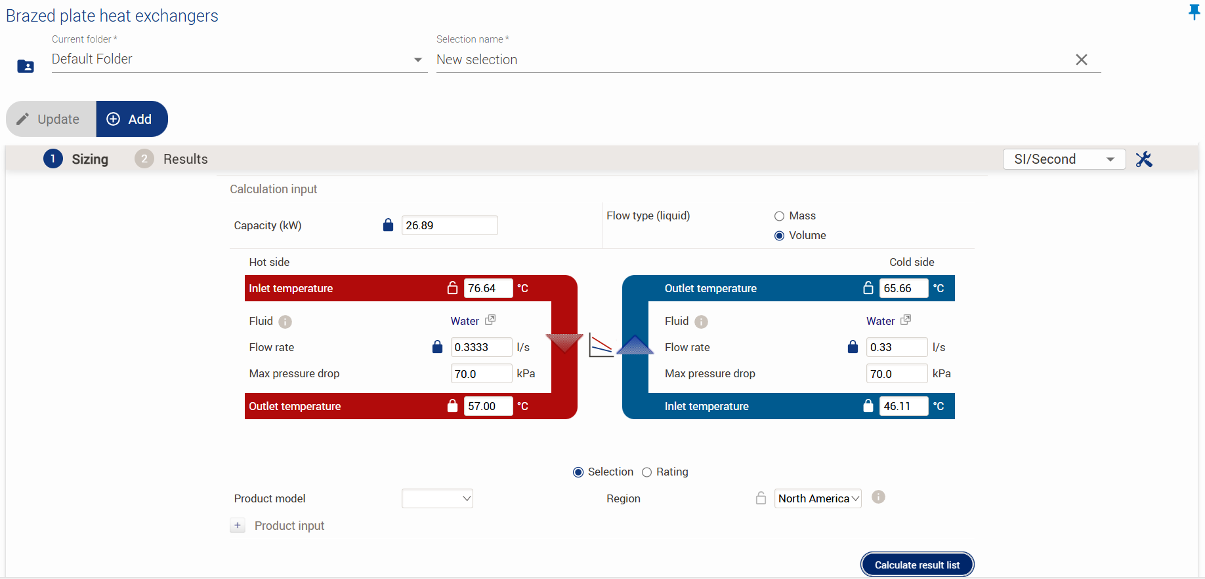
Heat Exchanger Alfa Laval
We now know the stock side should have a flow of 11.3L/min and to assume a nominal input temperature on the cold side of 20°C
New selection*
Max Heat Transfer
Max Flow Rate
Max Flow Rate
Min Outlet Temperature
Max Inlet Temperature

Slide 18
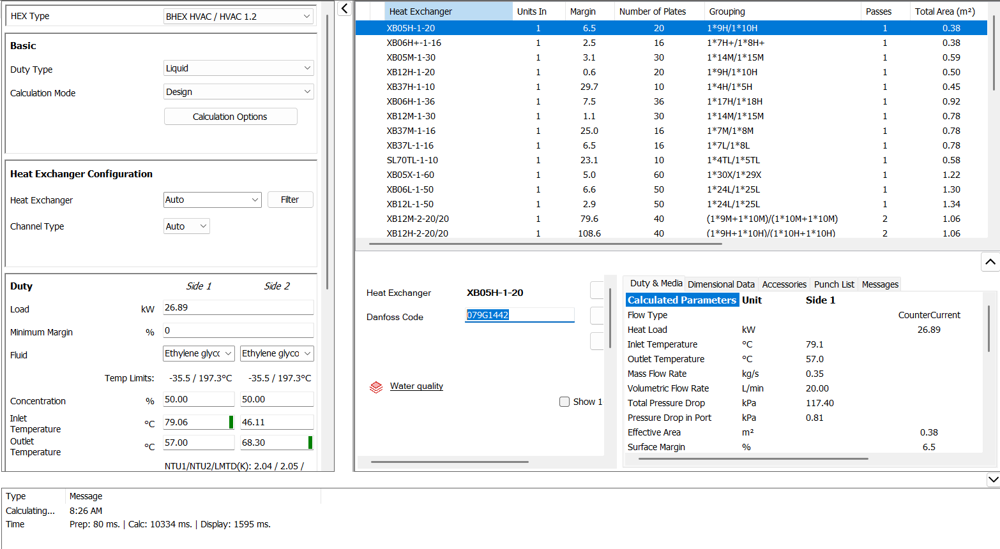
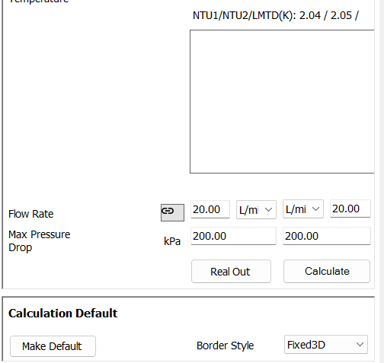
Heat Exchanger Danfoss
Danfoss HEXSelector | Danfoss

Slide 19
Heat Exchanger Comparison
Heat Exchangers.xlsx
1
2
3
Some HXs stated their max operating values and other stated what was imported into a calculator
Total area x pressure should be proportional to the heat transfer.
Pressure drop: 30 kPa
Pressure drop: 7 kPa
Pressure drop: 20 kPa
** The heat transfer of 26.888 kW is considerable conservative on its own.
As turbulence increases, so does the pressure drop and heat transfer. I expect this means that as pressure drop increases, so does the heat transfer.

Slide 20
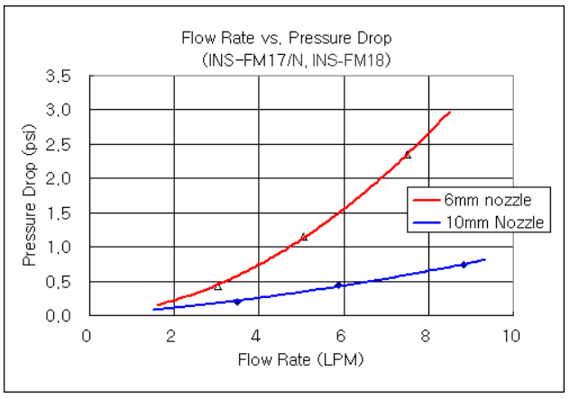
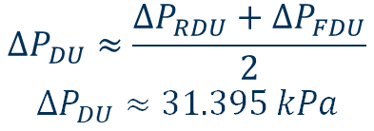

System Architecture: Current
Assumptions:
0% LTR
Temp
60 ⁰C (GM Parts)
20 ⁰C (FDU + RDU) this gives us a conservative estimate; as temperature increases pressure decreases
Flow (Ideal)
20 L/min (system)
10 L/min (FDU)
10 L/min (RDU)
∆P = 24.3 kPa
Confidential Thermal Architecture and Pressure Drops
∆P = 6.895 kPa
RDU
Flowmeter
$$∆P_{DU}≈\frac{∆P_{RDU}+∆P_{FDU}}{2}$$
$$∆P_{DU}≈31.395 kPa$$
FDU
Flowmeter
∆P = 24.7 kPa
∆P = 6.895 kPa
$$∆P_{other}≈56.2231 kPa$$
^ From MY24 AWD LYRIQ. The OBCM2 is removed but a few significant bends in the added piping is expected to increase the pressure drop to make it about the same as the MY24 AWD LYRIQ.
$$0=∆P_{pump}+∆P_{DU}+∆P_{other}$$
$$∆P_{pump}=−∆P_{DU}−∆P_{other}$$
$$∆P_{pump}≈−87.618 kPa$$
Radiator
Split Loop Direction
*
IPE
80 W
Pump
∆P = - ? kPa
* The raised IPE should not add significant resistance to the system. Whatever pressure drop occurs when the coolant travels up will be added back once the coolant moves back down.
Source of Pressure Drops: Magna Pressure Drop PowerPoint – Linearly interpolated from 9-12 L/min
(I don’t think I can share a copy because it is confidential? Need access to GT SharePoint)
Notes:
PUMP: Increasing flow rate, increasing pressure because increasing work,
Valve adds resistance to loop, valve decreasing pressure
-so pump increases [ressure
LTRA: Low Temperature Radiator- Crossflow heat exchanger for cooling coolant using air
Cihx

Slide 21
System Architecture: Pressure Requirements
The HX effectively replaces the stock drive units (which are in parallel) and OBCM2. See the following slide for more detail.
Stock:
Drive Units: ~26.9402 kPa
OBCM2: ~17.9051 kPa
Total: ~44.8453 kPa
This means if the added components have a pressure drop of less than 44.8 kPa, the flow should be 20 L/min.
This is not the case for the current system, which appears to have a pressure drop of about 31.4 kPa. Either the pressure needs to be under 31.4 kPa, or the current system has a larger pressure drop than 31.4 kPa due to additional bends.
Each 90 degree connector can add a pressure drop of about 0.24 kPa (see here for more detail). It is conceivable there are 10 bends which would contribute a total of 2.4 kPa of pressure drop.
Confidential Pressure Drops

Slide 22

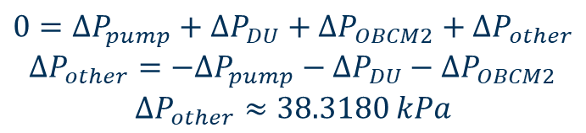
System Information: MY24 AWD LYRIQ
$$∆P_{DU}≈\frac{∆P_{RDU}+∆P_{FDU}}{2}$$
$$∆P_{DU}≈26.9402 kPa$$
Assumptions:
0% LTR
60 ⁰C
Flow
20.4 L/min (system)
10.1 L/min (FDU)
10.3 L/min (RDU)
Confidential Thermal Architecture and Pressure Drops
∆P = 23.3266 kPa
Rear Drive Unit
RDU
RTPIM
FDU
FTPIM
Front Drive Unit
Curtesy of MAC
Radiator
OBCM2
2.5969psi=17.9051kPa
∆P = 30.5537 kPa
Split Loop Direction
IPE
80 W
*∆P for Radiator, IPE is not given. It is approximated as:
Pump
∆P = -83.1633 kPa
$$0=∆P_{pump}+∆P_{DU}+∆P_{OBCM2}+∆P_{other}$$
$$∆P_{other}=−∆P_{pump}−∆P_{DU}−∆P_{OBCM2}$$
$$∆P_{other}≈38.3180 kPa$$
Source of Pressure Drops: GM Garbage Collector V3 https://anl.box.com/s/b6m2rktyqaqkx6ymi9irjzm4hzs1ls4f
(Need EcoCAR BOX Access)
Notes:
PUMP: Increasing flow rate, increasing pressure because increasing work,
Valve adds resistance to loop, valve decreasing pressure
-so pump increases [ressure
LTRA: Low Temperature Radiator- Crossflow heat exchanger for cooling coolant using air
Cihx

Slide 23
Diagram
5/8” Hose
1”-11 ½ NPT
Bleeder valve
3/4” Hose
14
To Radiator
5
6
Pressure
Transducer
From EDU Loop
Flowmeter
1
13+15
HX
Out
In
2
Housing
S4
S1
Flow Restrictor for FEDU Loop
Stock
Pump
4
8
Reservoir
12
S3
S2
2
Housing
In
Out
To EDU Loop
3
Flow Restrictor
1
11
Pump
Pressure
Transducer
From IPE
5
6
7
Put this at high point of FEDU loop

Slide 24
System Architecture: Proposed
RDU
Flowmeter
Flow Restrictor
Confidential Thermal Architecture
FDU
Bleeder Valve
Flowmeter
HX
Team Pump
Flow Restrictor
96 W
Coolant Reservoir
Radiator
IPE
Split Loop Direction
80 W
Flowmeter
Pressure Transducer
Pump
Pressure Transducer
Notes:
PUMP: Increasing flow rate, increasing pressure because increasing work,
Valve adds resistance to loop, valve decreasing pressure
-so pump increases [ressure
LTRA: Low Temperature Radiator- Crossflow heat exchanger for cooling coolant using air
Cihx

Slide 25
BOM
https://gtvault.sharepoint.com/:x:/s/ECE/EcoCAR/IQDrzrVUKhcvTZduIMjvDLMzAQ_aPXZBBRcs_65Yqt2Rs8o?e=LRCEgL

Slide 26
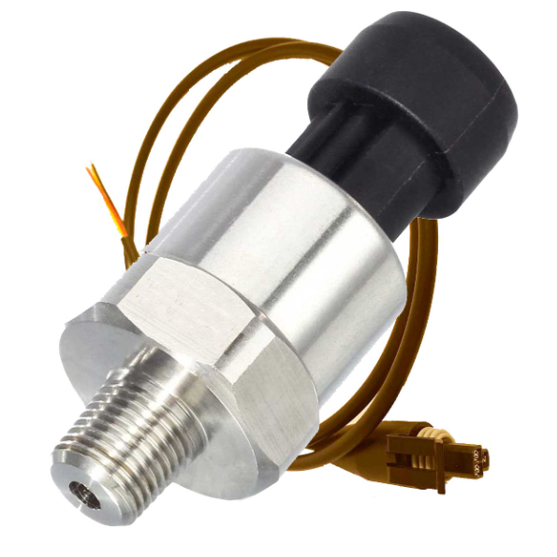
Pressure Transducer
PX3AN2BS100PAAAX Honeywell Sensing and Productivity Solutions | Pressure Sensors, Transducers - Industrial | DigiKey
X2
$129.82

Slide 27
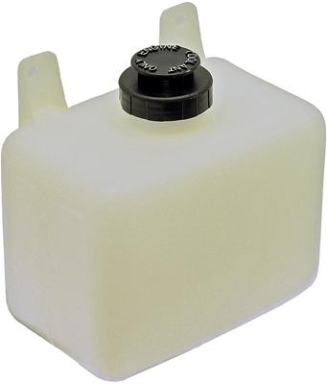
Coolant Reservoir
Dorman 603-001 Dorman Coolant Reservoirs | Summit Racing
$11.99

Slide 28
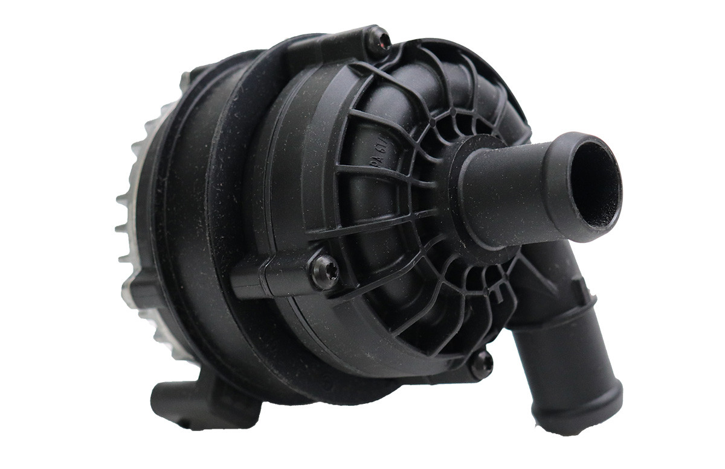
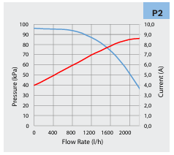
Pump
Max Flow: 20 L/min
Max Pressure:
EDU/Flow meters –> 31.395 kPa
Heat Exchanger -> 7 kPa
Total -> 38.395 kPa * 1.5 FOS = 58 kPa
Bosch 039202453G Water Cooling Pump, Compact Design | Order Online
20 L/min -> 87 kPa

Slide 29
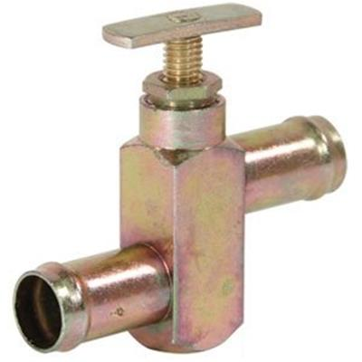
Flow Restrictors
¾” - Four Seasons 84707 Four Seasons Heater Valves | Summit Racing
Assumptions:
Minimum pressure drop: 2-3 kPa
Maximum pressure drop: ∞ kPa
5/8” - Four Seasons 84706 Four Seasons Manual Shut-Off Valves | Summit Racing

Slide 30
Slides on finding location for the HX in the vehicle were deleted since they show confidential CAD

Slide 31
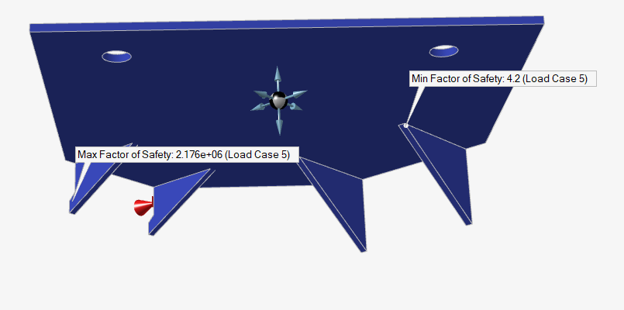
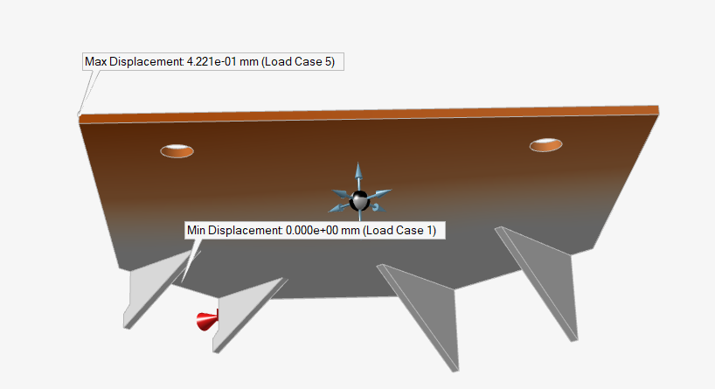
HX Location 1 and Mount
Material: 4130 Steel
Thickness: 1/8”
Loads:
2g vertical
5g longitudinal/lateral
Mass:
1.2+0.11x(18 plates) = 3.18 kg
0.054 liters x 18 channels = 0.972 liters = 0.97 kg
Total = 4.152 kg

Slide 32
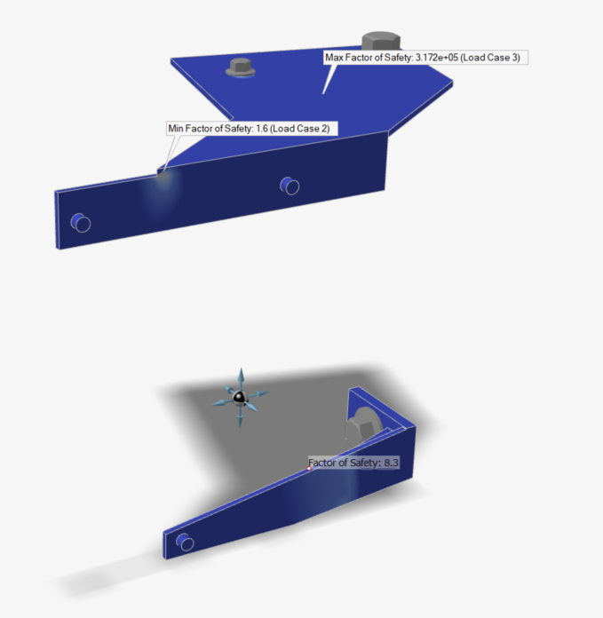
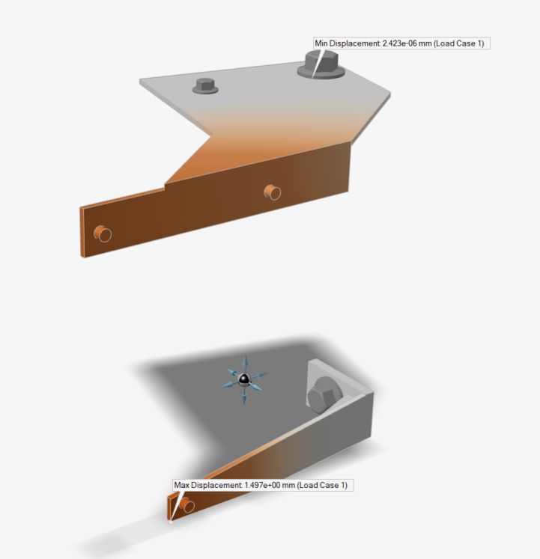
Coolant Reservoir Mount FEA
Material: 4130 Steel
Thickness: 1/8”
Loads:
2g vertical
5g longitudinal/lateral
Mass of coolant reservoir:
72oz water = 2.125kg

Slide 33
Information Requests
General Inquiries | Alfa Laval
Call Contact Emmegi Heat Exchangers Inc. | USA
About Bell & Gossett Pumps | Contact & Support for Xylem Bell and Gossett Pump Products | Xylem US

Slide 34
Additional Resources
OG HX dimensions bell-gossett-brazed-plate-heat-exchanger-brochure.pdf
OG HX flow and heat rejection bell-&-gossett-brazed-plate-heat-exchanger-selection-tables.pdf
HX dimensions Alfa Laval
HX Flow and heat rejection table 1 new message
HX flow and heat rejection graph WB-Series-Brazed-Plate-Oil-Coolers.pdf
Parent: WB Series Brazed Plate Oil Coolers | Emmegi Inc.
Heat exchanger selection tool PHE Select tool | Alfa Laval

